Slide 1

Intro to
# With little-to-no prior experience
Shaun Jackson, Marissa Chemotti, Soo Park

Slide 2
Disclaimers
Goal of the workshop is to INTRODUCE you to R
Notes:
Not receiving funding to give this workshop

Slide 3
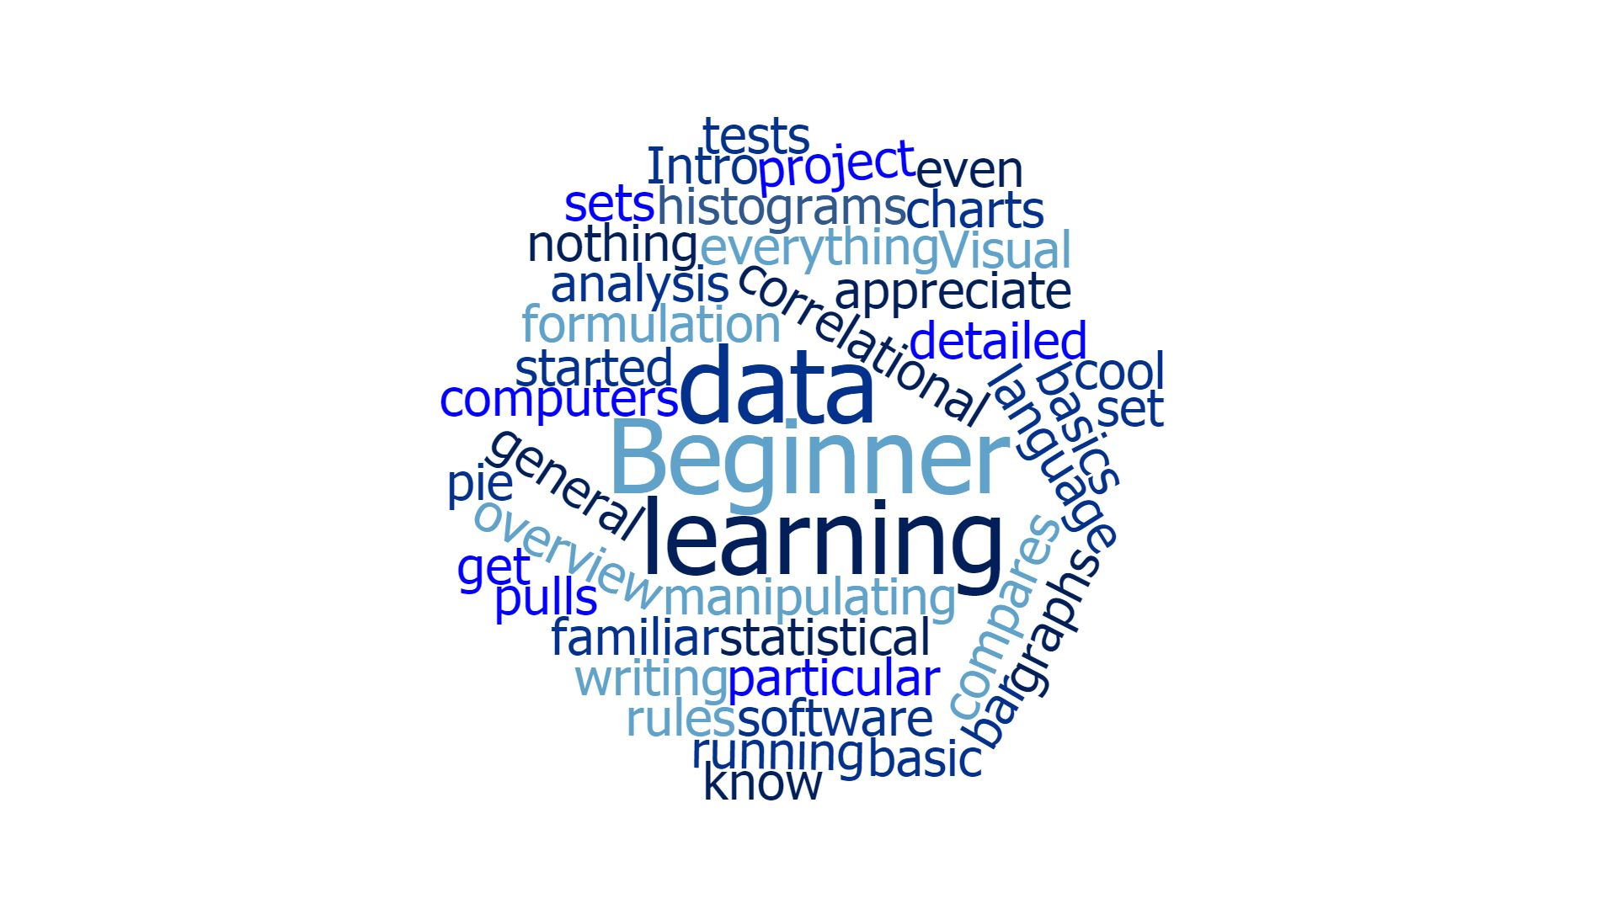
Notes:
Word map from form responses
Key words: Data, Beginner, Learning
Where to get started / anything!
Data analysis & visualization

Slide 4

GOALS
## INTRODUCE TO R ##
# Intro to common functions
# Exploring datasets
# Manipulating datasets
# Data analysis and visualization
“Resources to continue learning”
Notes:
Introduction to common functions in R
Exploring datasets
Manipulating datasets to refine your data frame
Then visualizing and analyzing with descriptives and plots
Resources to continue learning and practicing on your own
Aren’t even skimming the surface of the possibilities: get you started

Slide 5
BENEFITS OF
# Open-source statistical software
# Valuable tool for data manipulation and analyses
# Interdisciplinary application
# Open-source resources
Notes:
Unlike some popular statistical software packages, R is open to the public and free to download including additional packages/functions
R is a valuable tool: to clean, manipulate, analyze, and visualize data with more flexibility to your preferences
Generalizable statistical software: R is empowering in many disciplines
Because R is widely used, many resources and an online community

Slide 6
LEARNING
## Hands on learning is key ##
Notes:
Like any language: R requires patience and consistent practice

Slide 7
LEARNING
## Hands on learning is key ##
# Find/make a meaningful task
# Relevant to you and your goals
Notes:
Key to consistent practice is finding or making a task relevant to you and your goals

Slide 8
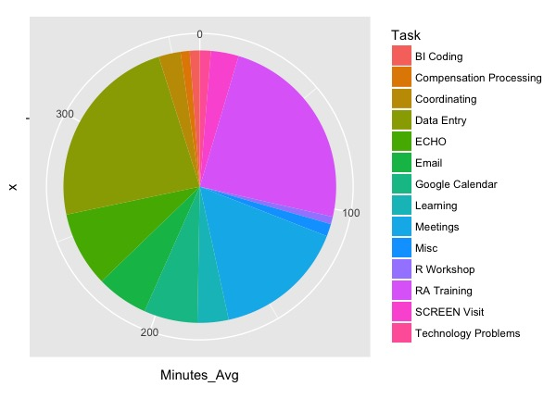
LEARNING
## Hands on learning is key ##
# Find/make a meaningful task
# Relevant to you and your goals
# Ex: Task Tracking Project
Notes:
Ex: Task Tracking for work
Created a csv file
Used functions in R to define categories of my tasks
Used descriptives and write scripts to define dataset
Used visualization functions to understand where a majority of my time was spent

Slide 9
LEARNING
## Hands on learning is key ##
# Find/make a meaningful task
# Relevant to you and your goals
# Ex: use open-source datasets online
Notes:
Many open-source datasets you can find relevant to your field online

Slide 10

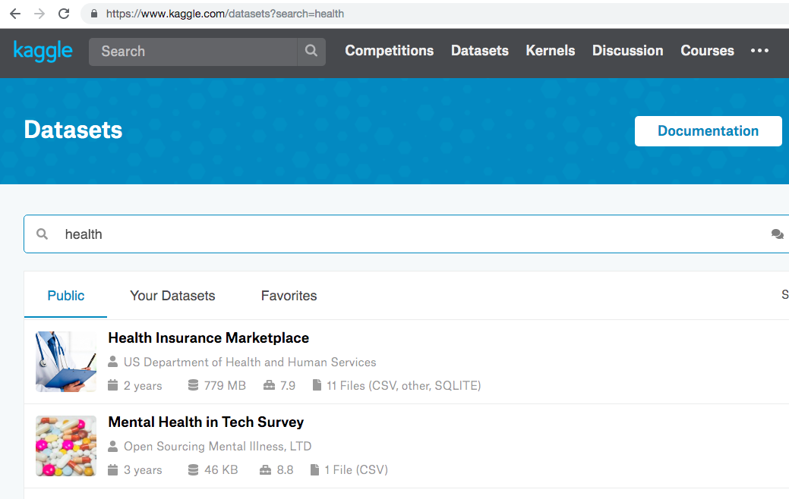
Open-source datasets via kaggle
Notes:
Many open-source datasets you can find relevant to your field online
Kaggle is a great option for practice datasets
https://www.kaggle.com/datasets

Slide 11
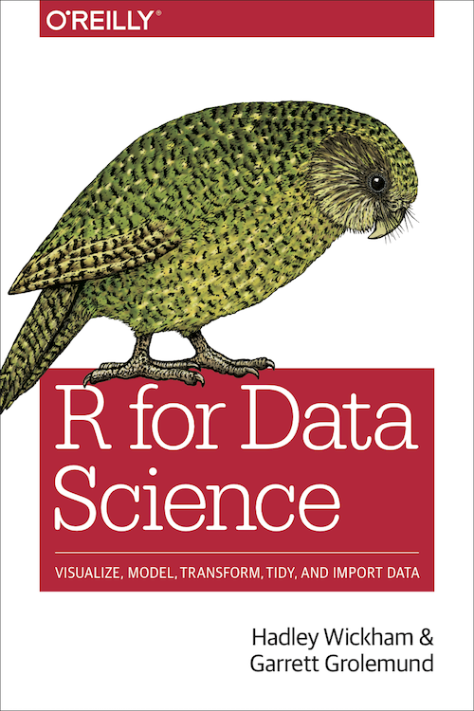
Resources
R for Data Science: Open-Source Textbook
Notes:
R for Data-Science open source online textbook
https://r4ds.had.co.nz/

Slide 12
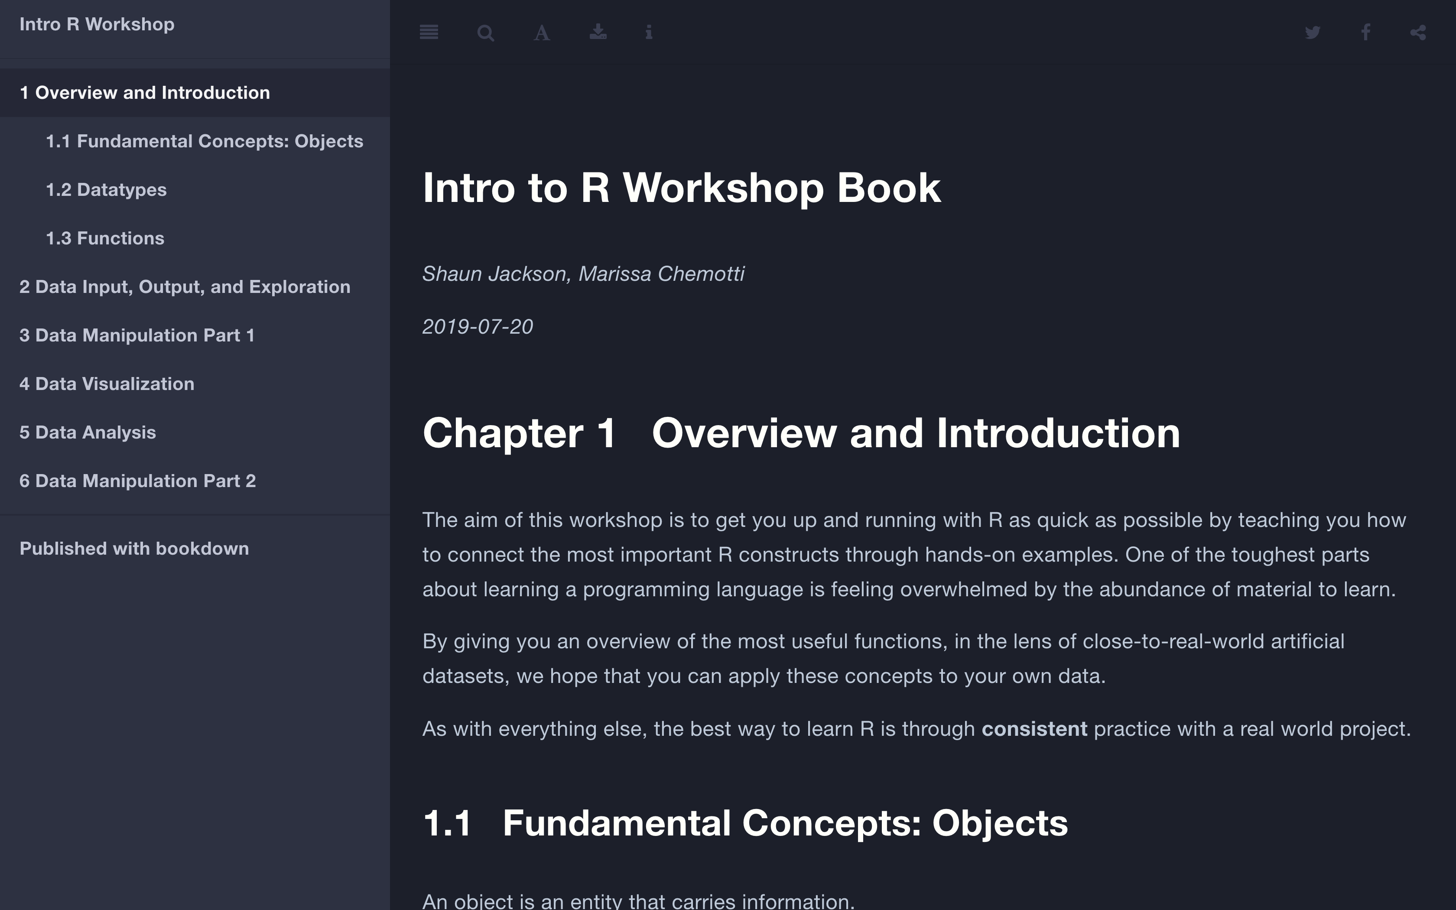
Resources
Intro to R Workshop: Open-Source Textbook
Notes:
Intro to R Workshop: open source online textbook, pairs with R files/examples from workshop
https://shaun-jacks.github.io/intro-R-workshop-mind/

Slide 13
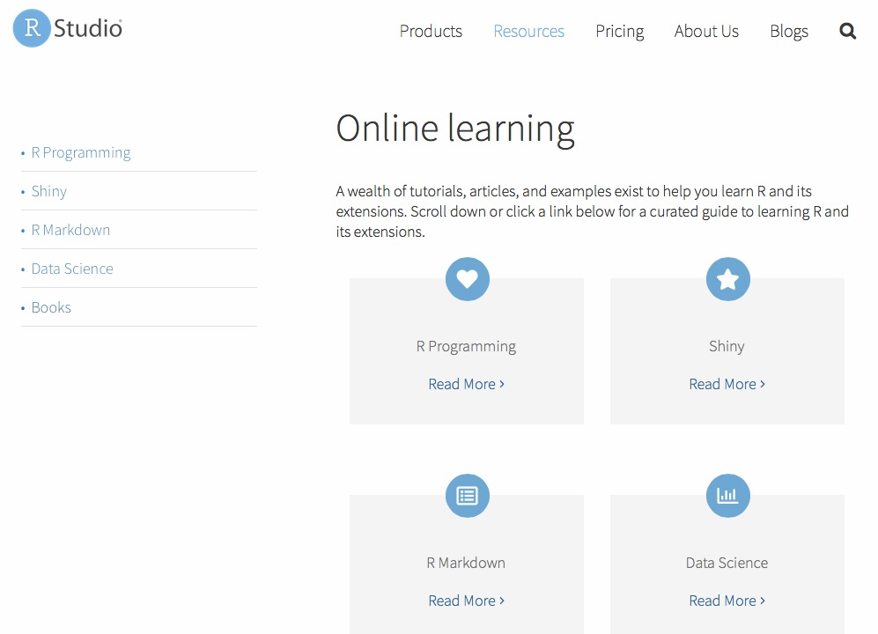
Resources
Rstudio Online-Learning Portal
Notes:
Online learning portal with videos, explanations by Rstudio
https://www.rstudio.com/online-learning/

Slide 14

Resources
Free R Programming Courses
Intro to R for Data Science by Microsoft- Free
Notes:
Free online courses on EdX, I took on by Microsoft Office
https://www.edx.org/v2/course/introduction-to-r-for-data-science-3

Slide 15
Data Types/Classes

Slide 16
classes
List
Vector
Factor
Numeric
Data Frame
Character
Logical

Slide 17
class: numeric
Numeric
1, 2, 3, 4

Slide 18
class: character
Numeric
Character
String/words/qualitative
“Blue”, “Green”, “Yellow”

Slide 19
class: logical
Numeric
Character
Logical
TRUE, FALSE, NA

Slide 20
class: Factor
Represent categorical data
Can perform stat. operations
Factor
Numeric
Character
Logical

Slide 21
class: Vector
Contains data points of
1 data type
vect1 <- c(3, 5, 7)
vect2 <- c(“Yes”, “No”, “Yes”)
vect3 <- c(TRUE, FALSE, FALSE)
Vector
Factor
Numeric
Character
Logical

Slide 22
class: Data Frame
Frame containing data (csv, excel, text, etc.)
organizes data observations into (rows, columns)
Data Frame
Vector
Factor
Numeric
Character
Logical

Slide 23
class: List
List
A list that can contain multiple data types
Data Frame
Vector
Factor
Numeric
Character
Logical

Slide 24
Open RStudio > print(“hello world”)

